Slide 1

Doubling Down on ChatOps in the Enterprise
Daniel Perez
DOES 2016
Notes:
1 MIN
Name, R&DIT, HPE
3rd chapter of our DOES/Devops journey – TITLE
ChatOps has exploded within IT field over last year
Concept we introduced at DOES
Initial investments
Take and run with it in your teams

Slide 2
Agenda
Our DOES Journey
What is ChatOps
Overview of Hubots
Design and Security Considerations
Live demo

Slide 3
Our DOES Journey
DOES 2014 – Continuous Integration as a Centralized Service Using ElectricFlow
Self-service deployment of ElectricFlow
One of the largest implementations of solution
Used by 3k+ developers and 1,000,000+ jobs a month
Baseline projects, environment cleanup, simplified security strategy
DOES 2015- Self-healing and Monitoring in a Devops world
R&D IT’s investments towards end-to-end applications monitoring and self healing
Integrated pipelines, reproducible api’s
In-depth insight into environments with open source monitoring solutions
Initial ChatOps investments
Notes:
~ 3 min (1m)
Provides core SDLC solutions throughout all facets of IT : R&D, IT, Business
All of our solutions are highly available, 24x7 support, and scaled out
DOES 2014
We shared our deployment of EC as a self-service model, unlike anything out there today
Common environment for all developers, easy onboarding and standardized build processes
DOES 2015
Take what we learned, apply to all other apps
Nagios solution: 600 servers, +1500 services
End to end monitoring and integrated pipelines
Initial ChatOps investments
Take that to other parts of org
DOES 2016

Slide 4

What Is ChatOps?
Pulling tools into the Conversation
ChatOps is a term coined by Github to describe their growing culture of “Putting tools in the middle of the conversation”
#ChatOps
The Idea
Persistent chat – Single point of collaboration
“One stop shop” - Graphs, quick info, run automations
Chat tool agnostic – Many flavors, integrations
Hubots – Open source, nodeJS based, highly customizable, api driven
Notes:
~3 min (4:00)
Combine persistent chat and developers in a single point of conversation/collaboration through conversation driven devlopement– you have a shared place where developers can collaborate with a tool that can help kick off automated tasks
You’ve got defect tools, scm, CI, pipelines, quality tools out there that work well but there is nothing that really ties them together, this is where chatops shines
Key enabler of DevOps with the use of persistent chat
One location where all key collaboration takes place
History, tags, referencing others, referencing conversations
Increase volicity
Self service automations
“One stop shop”
Place that documents interactions
Single point of collaboration for working through issues
Enables automation with ever increasing insight to your environments
Chat tool agnostic
Lots of flavors : Flowdock, Slack, Hipchat, IRC, Mattermost
Variety of adaptors for Hubot
Hubot written around the “adaptor” concept – standardize messaging, storage/persistent data, concept of “rooms”
Hubot
Automation is everything – Hubot really lets you “automate all the things”

Slide 5

Hubot - Hammer
What can he do?
Core features
Data lookups
Graphing
Run automations
Alias commands
Application metrics/stats
Tell jokes
Persistent data
Redis Brain… stores user info, chat history, key/value pairs
Mongo integration… Mongo based store for script data
Integrated pipeline
GitHub Enterprise... Inner sourced for all developers to fork on their own
ElectricFlow… Compiles and deploys hubot
Flowdock… End to end notification on the deploy process
Hubot-webhook listener... Self deploys on known good branch
Notes:
~ 3min (10:00)
Core features
Data lookups – GHE stats
Nagios
Grafana/Kibana visualizer
Integration to EC
Alias is a must have
Tell jokes
Nagios status checks
Graphing statsd performance data – ElectricFlow, SCM solutions, GitHub Enterprise
Integrations to our various SCM tools for analytics, environment discovery, and general app health
Self-healing – Restart services, status checks and repairs
Chaos-Monkey – Break all of the things
Automated selenium testing – Kick off entire end-to-end test suits for our various applications
Jokes – he’s a comedian!

Slide 6








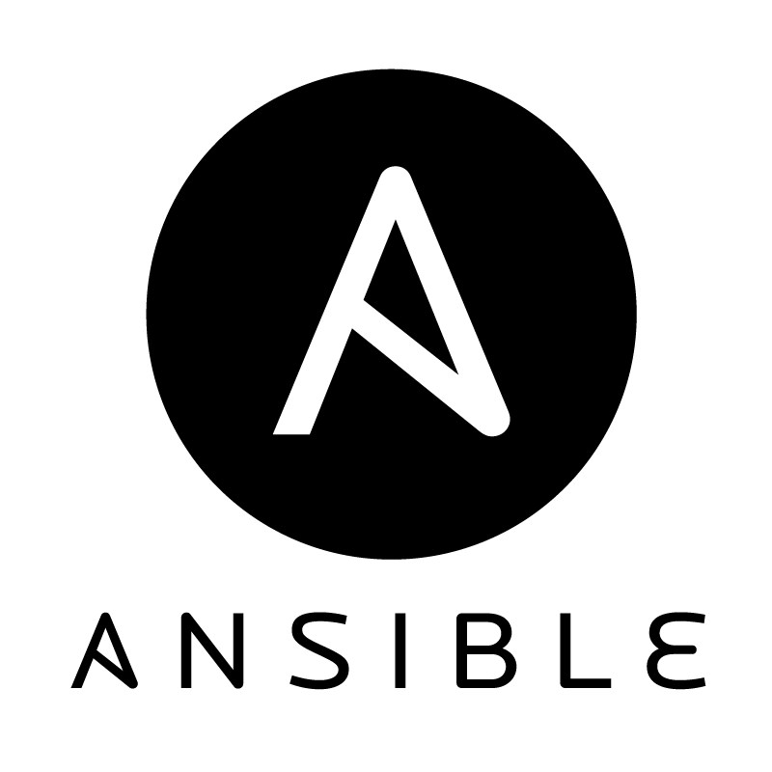

ChatOps
Key ChatOps technologies
Notes:
30 seconds
13:00

Slide 7
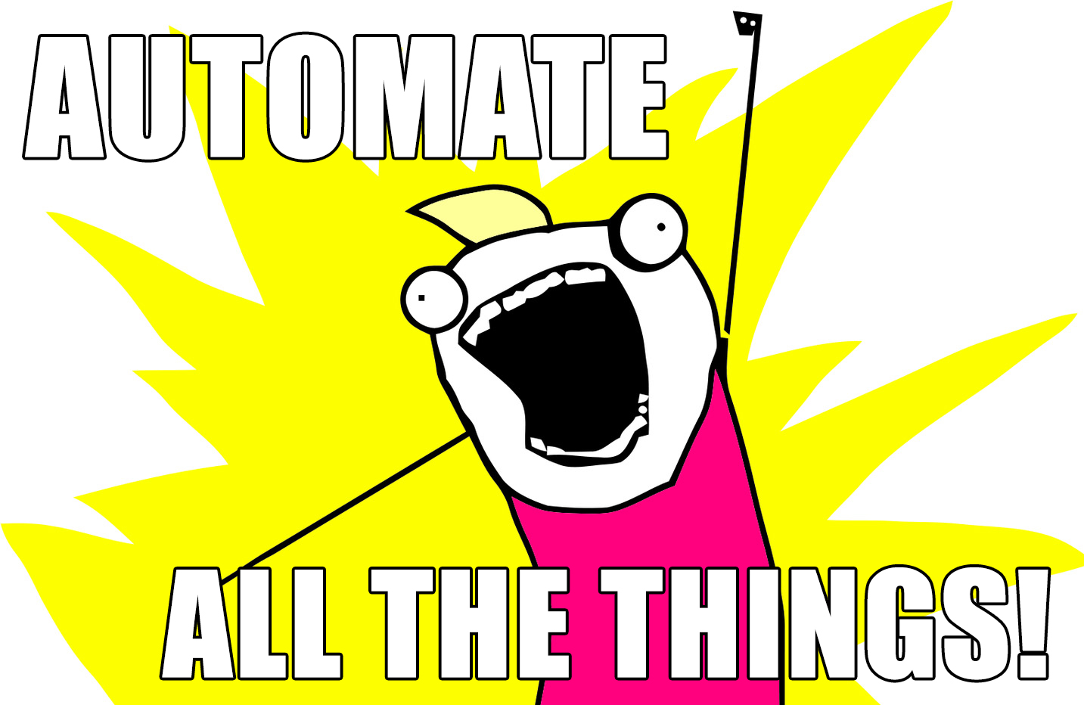
…..sort of
Notes:
True, to a certain point
There are certain things that really shouldn’t be automated
Some things can be over-engineered, to the point where the value gained from implementing automation is simply not worth the effort
Hubot or chat tool is down, you’re dead in the water
Go over more of this in lessons learned

Slide 8
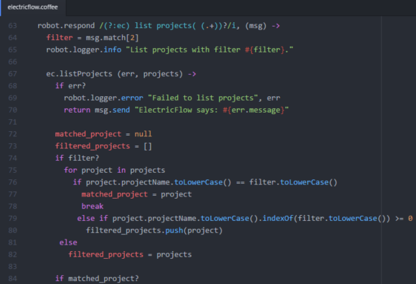
Hubot
Design considerations and best practices
Lightweight
Small 2x4
Go cloud!
Dockerize hubot
Automated builds
Tie to SCM
Create automated pipeline to test/deploy
Best practices
Keep it simple!
Avoid single point of failure
Keep it chat tool agnostic
Reuse code as much as possible
Notes:
~ 2 min ( 6:00 )
Good guidelines for successful automations
Keep it simple
Keep it generic
Avoid single point of failure
Keep it chat tool agnostic
Reuse code as much as possible

Slide 9

ChatOps
Security considerations
Express framework
Enables basic auth for ports
Implement Nginx proxy pass for SSL endpoint
Hubot.env
Store all related env variables in this file
Secure file with correct permissions (chmod 600)
Avoid personal accounts with integrations (app accounts are safer)
Hubot auth
Chat Data stored off-premise
Ensure security team vets tools
Cleanse any confidential data that should not leave network/premises
Implement SSO on chat platforms that support it
Stand up enterprise version of chat tools (HipChat, Mattermost)
Notes:
~2 min (8:00)
Open emphasis on the hubot security perspective – role based permissions, hubot auth, native ElectricFlow ACL’s

Slide 10
ChatOps
Food for thought
Lessons Learned
Fun stats
Pick tool that fits your use case
Keep integrations simple
Too much data can make things complicated
Not everything needs to be automated
Properly onboard team members
10+ applications onboarded (within our org)
70 active commands/integrations
30+ developers
100’s of daily calls to chatbot
Expanded to 10+ teams in the last 6 months
Notes:
~ 1min (13:30)
Tool features matter
Certain teams really need open chat rooms – slack
Inbox from flowdock
SSO – security in mind
“grouped conversations”
Don’t overload your chat with data
Only post stuff that matters
Graph only import things
Don’t automate everything

Slide 11
Live Demo
Overview of persistent chat
Common hubot commands
ElectricFlow performance metrics integration
Nagios/graphios Grafana integration
Self-deploy
Notes:
~ 5 min
14:30)
Overview of persistent chat – 1min
Common hubot commands – 1 min
ElectricFlow grafana integration – 1min
Nagios/graphios – 1 min
Self-deploy – 1 min

Slide 12
Summary
ChatOps
Hubots
Key enabler of DevOps with the use of persistent chat and
Conversation-Driven Development
Central place to collaborate
Accountability and audit trail
Node based and easy to set up
Integrations to a variety of chat tools
Chat tool agnostic – works on many chat platforms
Highly customizable
On demand automation
https://github.com/DOES16-HPE/ChatOps
Notes:
~ 1 min (19:30)

Slide 13
Questions?
Notes:
~ 5 min
(20:30)

Slide 14
Thank you
daniel.perez3@hpe.com

